Slide 1

Team_10: Social Media Sentiment Dashboard
Comparative Analysis of Twitter and News Headlines using Power BI & Python
CSCE 5320 Scientific Data Visualization
Lohitha Konidena, Sai Sathvika Potluri, Sai Karthik Nimmagadda
Computer Science and Engineering Department

Slide 2
Introduction & Problem Statement
Domain: Social Media Analytics & Visualization
The study aims to analyze the sentiments that differ between Twitter and news media platforms.
Problem Statement:
This research investigates the time-based variations of sentiment differences
between Twitter and News platforms and establishes patterns within the data.
Public understanding of both emotional trends and media tone and societal opinions can benefit from this idea.

Slide 3
Methodology & Workflow
Methodological Steps:
Data Collection – Twitter (Kaggle) & News (open-source)
The first step involves preprocessing through cleaning operations while adding labels along with date formatting.
Sentiment Mapping – Mapping 0/4 to Negative/Positive (Twitter); rule-based tagging (News)
Both datasets were connected by creating unified columns and getting them appended together.
Both Power BI and Python tools with Seaborn, Matplotlib, and WordCloud libraries were used for visualization purposes.
Insight Extraction – Trends, sentiment shifts, keyword analysis

Slide 4
Dataset Overview & Transformation
Dataset 1: Sentiment140 (Twitter)
1.6 million tweets
The dataset contains three main attributes: date, text, and sentiment with a scale from negative to positive (0 to 4).
Dataset 2: News Headlines
15,000 records
Attributes: publish_date, headline_text
Transformations Applied:
Removed nulls/duplicates
Unified column structure
The source was added to the data set while sentiment values received their corresponding mappings.
The analysis used the merged data from both sources in df_combined for unified investigation.

Slide 5
Task Abstraction & Tools
Targets:
Perform an evaluation of sentiment distribution together with its time-based evolution across different platforms.
Monitor how emotional operations transform throughout time intervals.
Review the most frequently occurring words present in the text content
Techniques Used:
The tools aggregate data while filtering displays data visually through lines, bars, stacked bars, and extracted keywords.
Tools Used:
The process of dashboard creation, along with filtering operations and interactive visual creation, is made possible through Power BI.
Python – WordCloud, time-series analysis, heatmaps

Slide 6
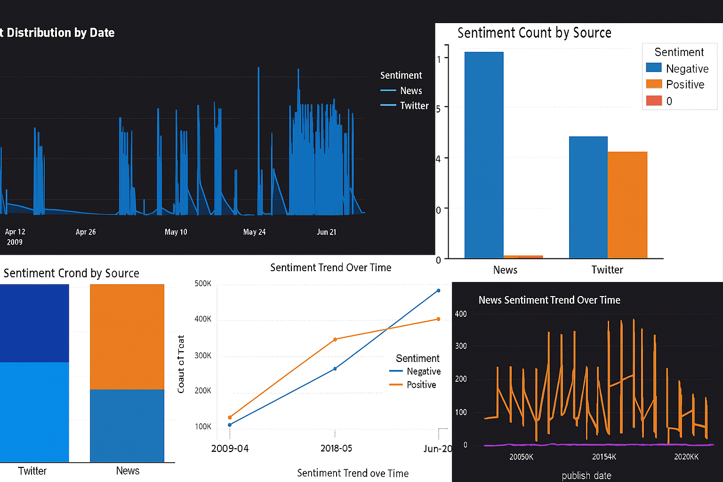
Power BI Visualizations (Summary of Key Graphs)
Figure 1: Sentiment by Date (Twitter) – Daily emotion spikes across the timeline
Figure 2: Sentiment Trend Comparison (Twitter vs News) – Time-series line chart
Figure 3: Sentiment Count per Source – Bar chart comparing volume by source
Figure 4: 100% Stacked Column – Shows proportional sentiment share by platform
Figure 5: Monthly Sentiment Trends – Highlights emotional tone fluctuations
Figure 6: News Sentiment Line – Year-wise evolution of news sentiment

Slide 7
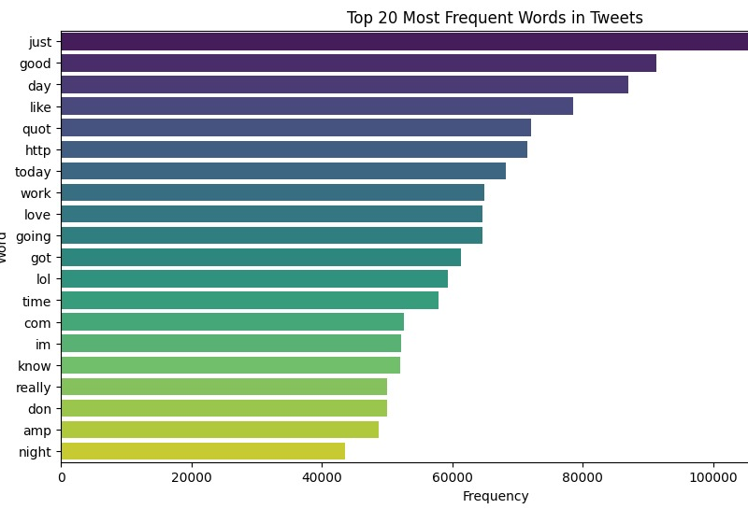
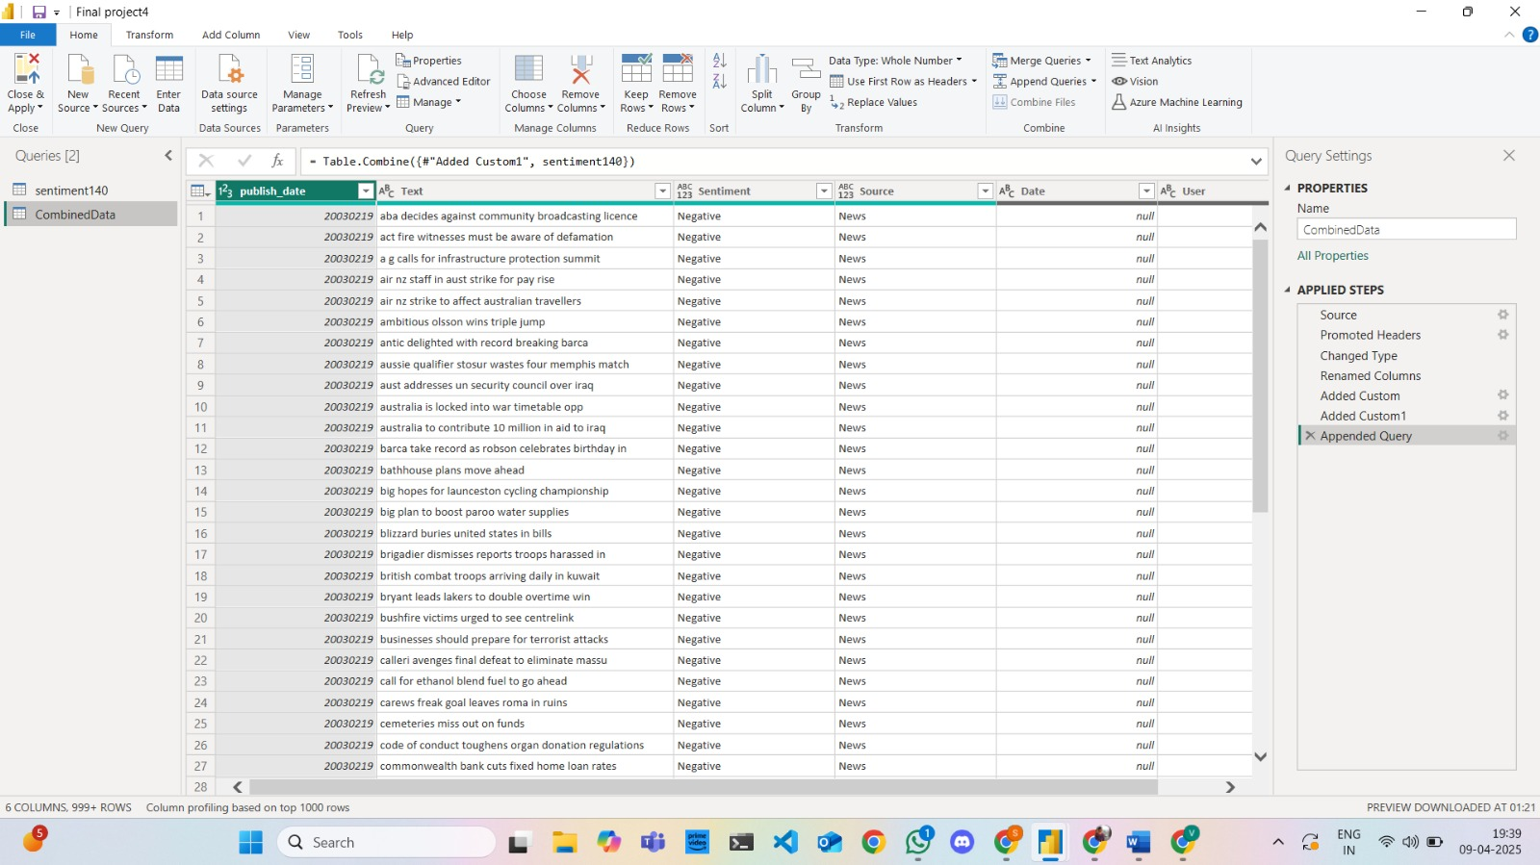
Python Visualizations
Insights:
WordCloud revealed topic relevance and public emotion
Python plots supported additional trend analysis

Slide 8
Results, Insights, & Work Management
Insights Gained:
The sentiment of Twitter content remained balanced while the News platform showed mainly negative sentiment.
Event-related spikes observed in timelines
The document contained regularly repeated keywords, which helped identify emotions expressed by users.
Team Contributions:
Lohitha: Power BI Visuals
Sathvika: Dataset preparation & integration
Karthik developed graphs with Python while preparing the reports.
Project Status:
The project activities for dataset preparation and analysis and visualization tasks have been finished.
Report and presentation finalized

Slide 9
Next Steps & Submission
For Project 2:
Include Reddit/YouTube sentiment
Used D3.js/Plotly for interactive visual storytelling
Add machine learning-based sentiment classification
Develop an HTML/CSS/JS webpage that contains embedded dashboards for hosting

